Slide 1
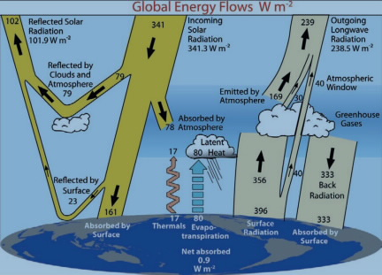
Why do we care about light and orbitals?
Light comes in (from the sun) and eventually leaves to keep the planet in radiative balance.
To understand climate and climate change, we need to get a handle on the many forms of light, and how they interact with various kinds of matter.
In particular, we need to have a clear understanding of the difference between glowing vs reflecting light

Slide 2
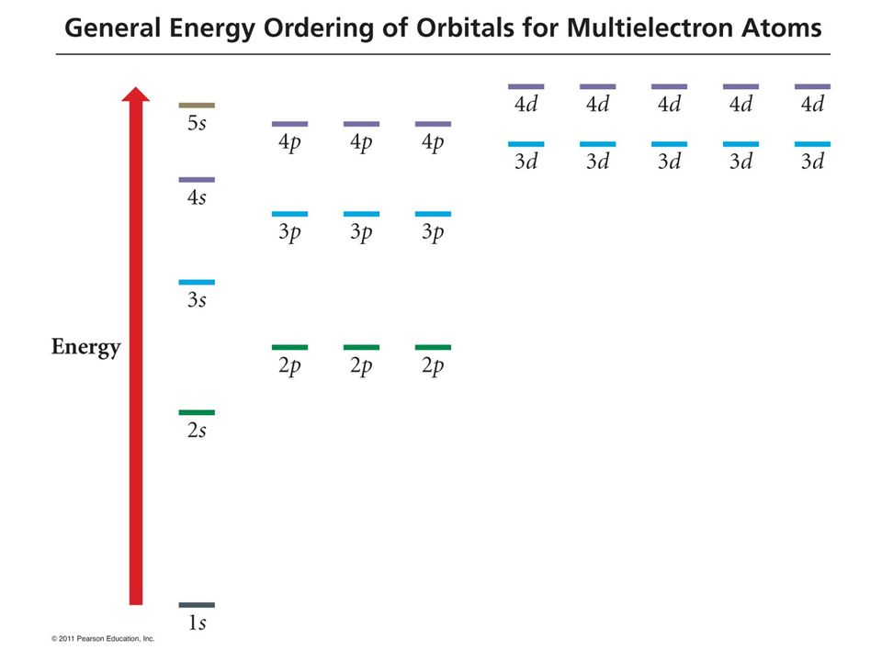
Recap: How atoms emit (glow)
Here we have our aufbau-prescribed state, also called the ground state of Neon (or, equivalently, Na⁺).
The gray arrow shows how a source of energy (like a flame, or electrical current, or a cosmic ray) moves an electron to a higher-energy orbital.
HOMO

Slide 3
Recap: How atoms emit (glow)
Now the atom is in an excited state.
However (as we’ve talked about), the electron doesn’t stay there long: it falls to a lower orbital and emits a photon in the process.

Slide 4
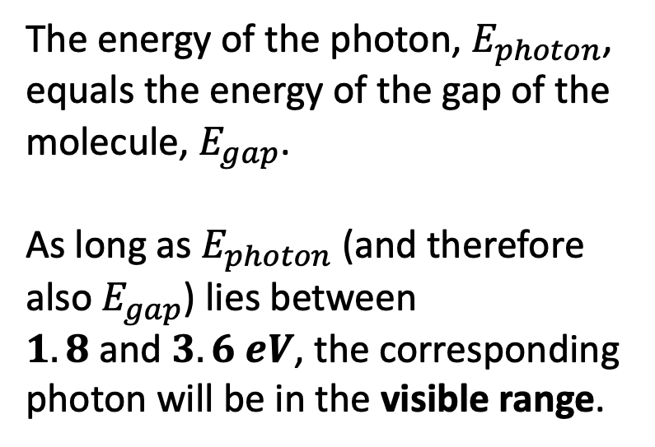
Recap: How atoms emit (glow)
The energy of the photon, $E_{photon}$, equals the energy of the gap of the molecule, $E_{gap}$.
As long as $E_{photon}$ (and therefore also $E_{gap}$) lies between $1.8 \text{and} 3.6 eV$, the corresponding photon will be in the visible range.

Slide 5
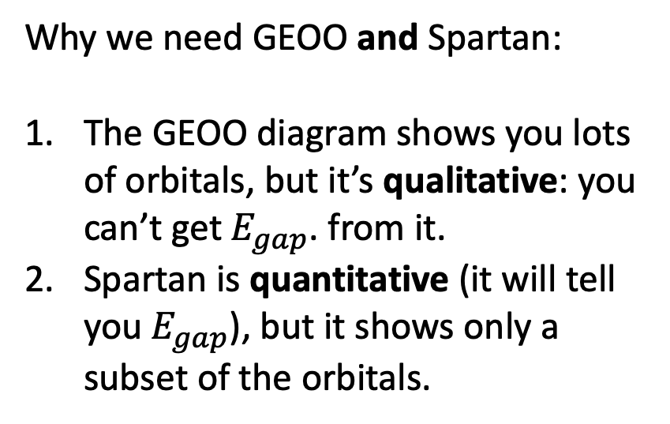
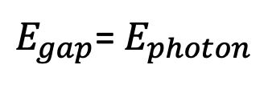
Recap: How atoms emit (glow)
Why we need GEOO and Spartan:
The GEOO diagram shows you lots of orbitals, but it’s qualitative: you can’t get $E_{gap}$. from it.
Spartan is quantitative (it will tell you $E_{gap}$), but it shows only a subset of the orbitals.
$E_{gap}$= $E_{photon}$

Slide 6
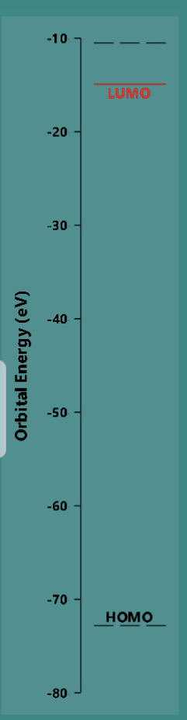
Example: Mg²⁺
Which orbital in GEOO corresponds to which orbital in Spartan?

Slide 7
Example: Mg²⁺
Which orbital in GEOO corresponds to which orbital in Spartan?

Slide 8
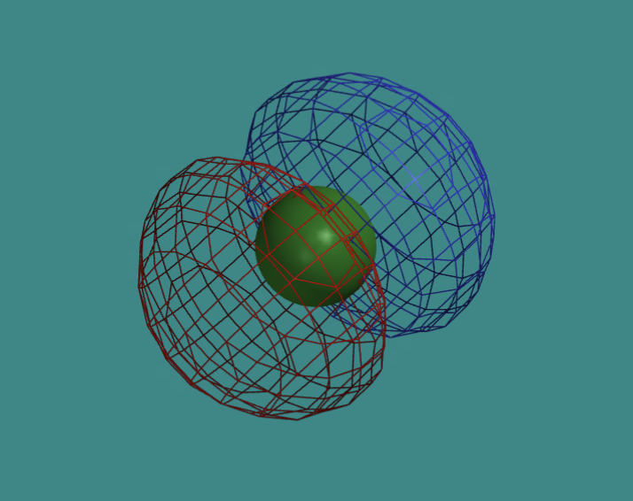
Example: Mg²⁺
Which orbital in GEOO corresponds to which orbital in Spartan?

Slide 9
Example: Mg²⁺
Which orbital in GEOO corresponds to which orbital in Spartan?

Slide 10
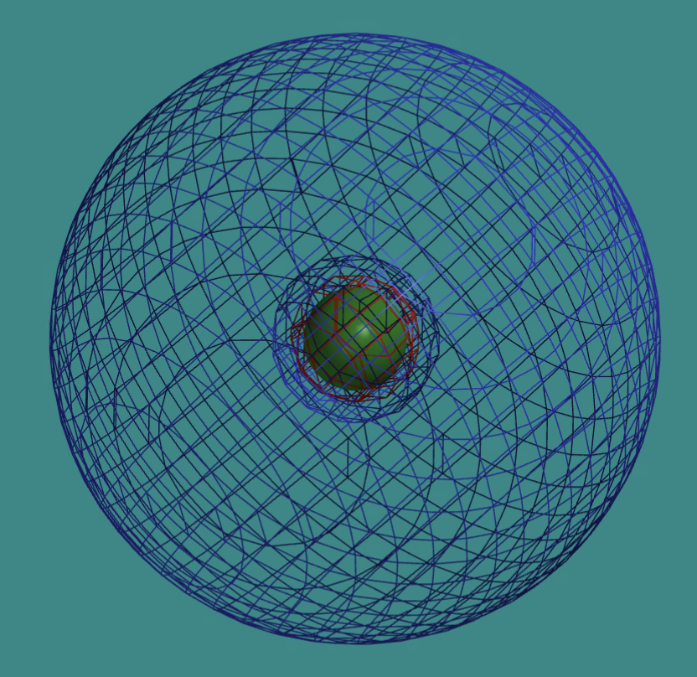
Example: Mg²⁺
Which orbital in GEOO corresponds to which orbital in Spartan?

Slide 11
Example: Mg²⁺
Which orbital in GEOO corresponds to which orbital in Spartan?

Slide 12
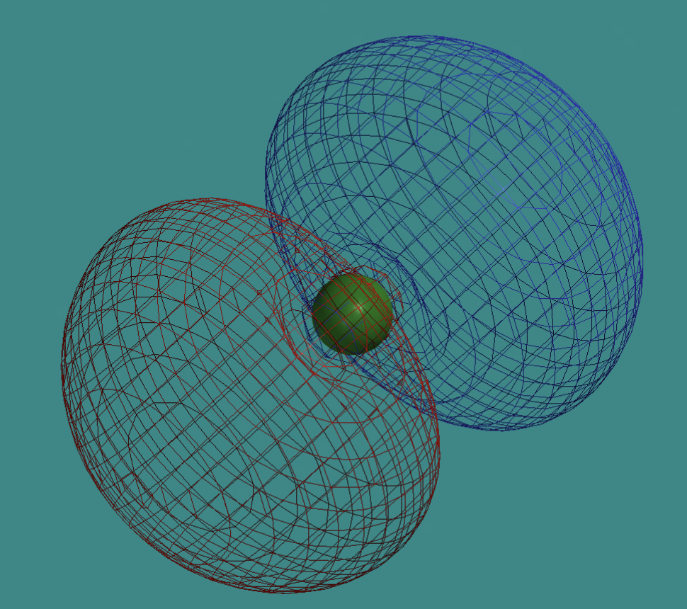
Example: Mg²⁺
Which orbital in GEOO corresponds to which orbital in Spartan?

Slide 13
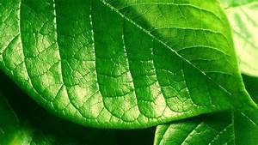
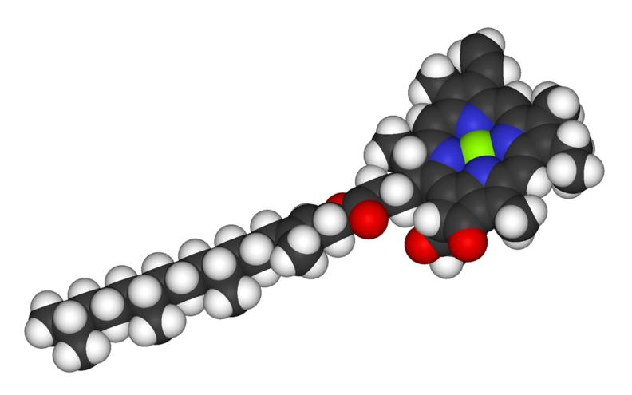
Orbitals are not just for atoms – molecules, solid objects also have them
The shapes of molecular orbitals are very different – they’re not s-orbitals, p-orbitals. However, the same ideas apply (HOMO, LUMO, gaps)
LUMO
HOMO
Molecular orbital energies of chlorophyll (artist’s conception)
Leaf with green chlorophyll pigment
Chlorophyll molecule
Chlorophyll HOMO

Slide 14
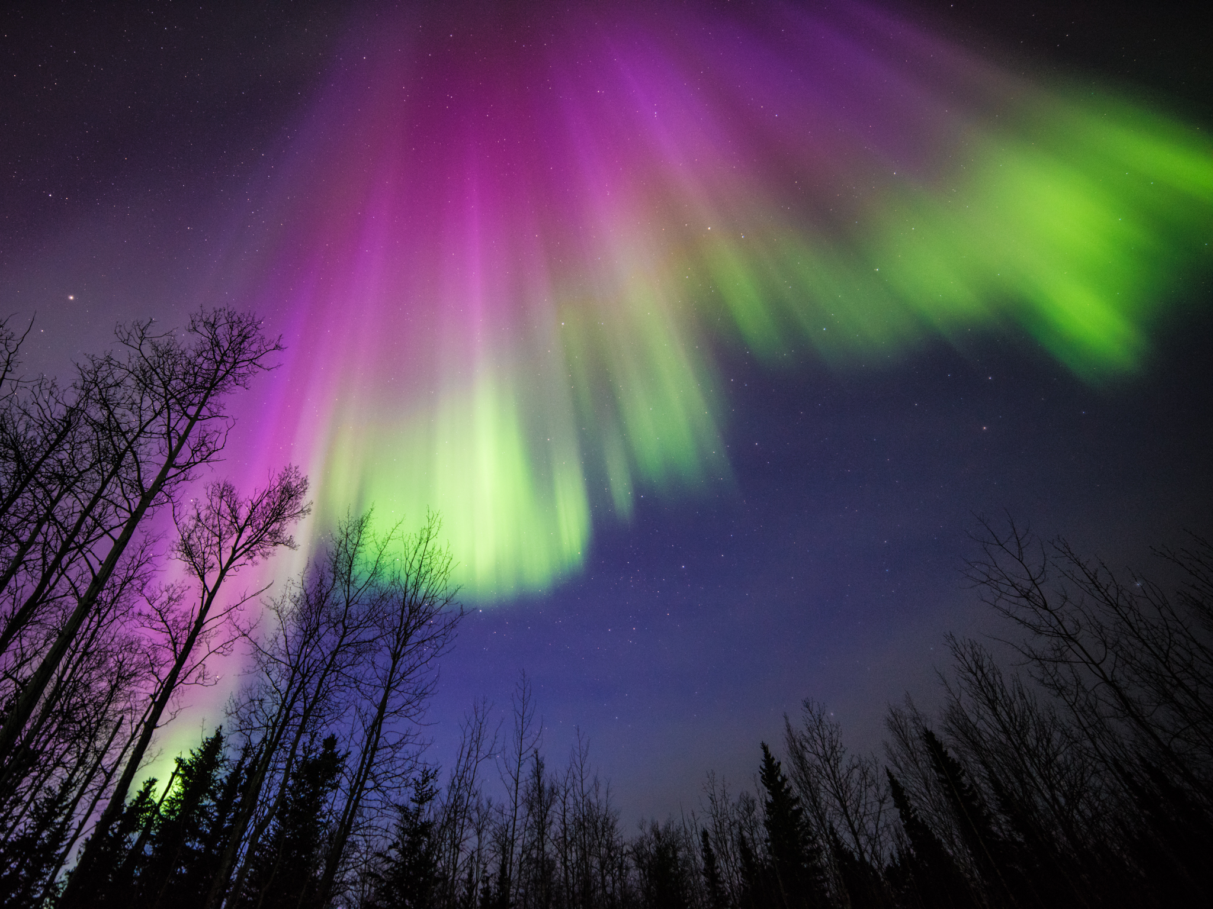
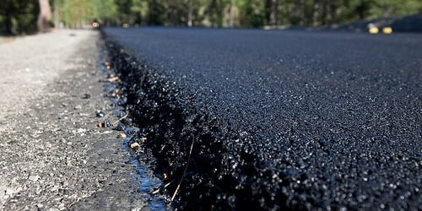
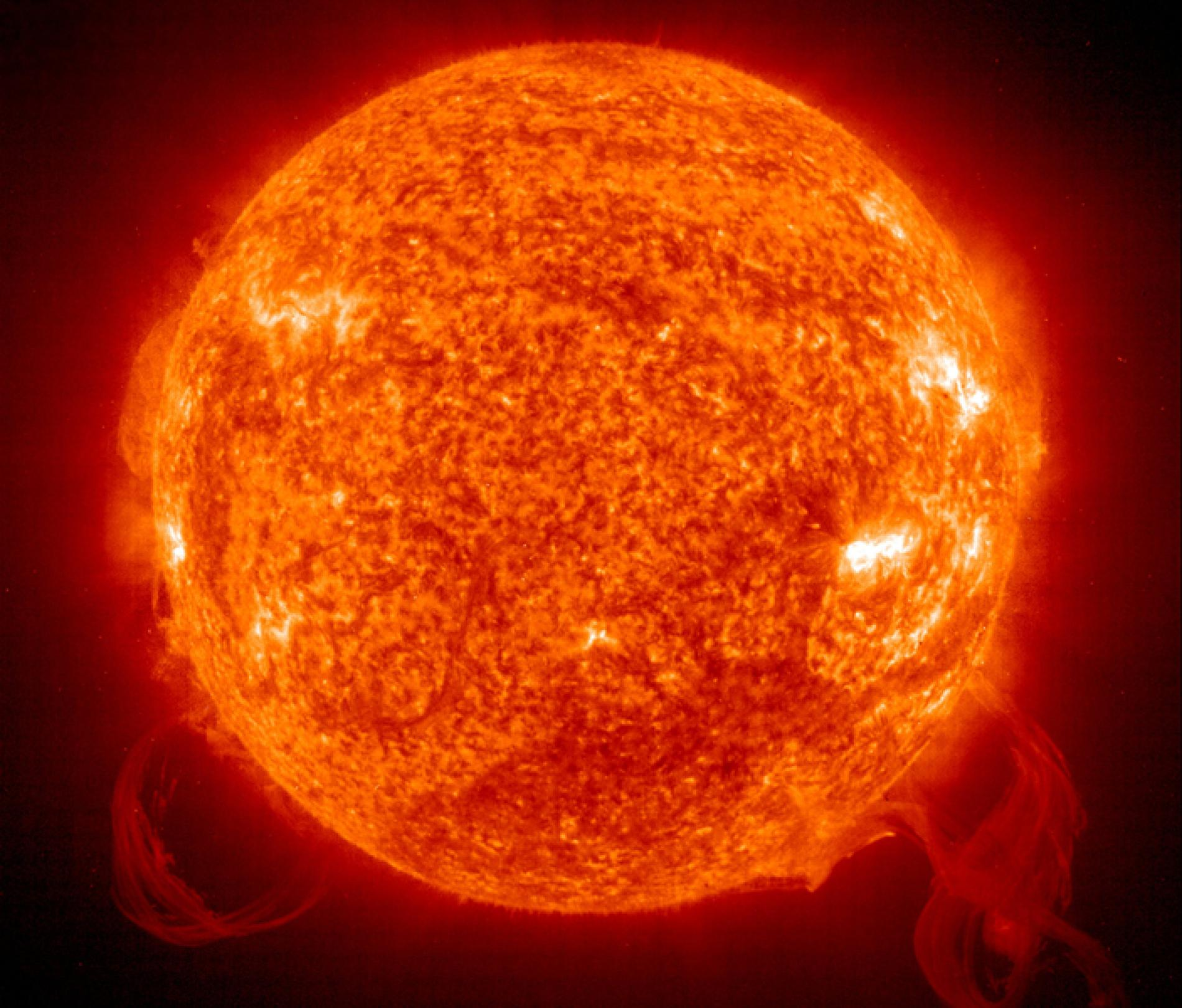
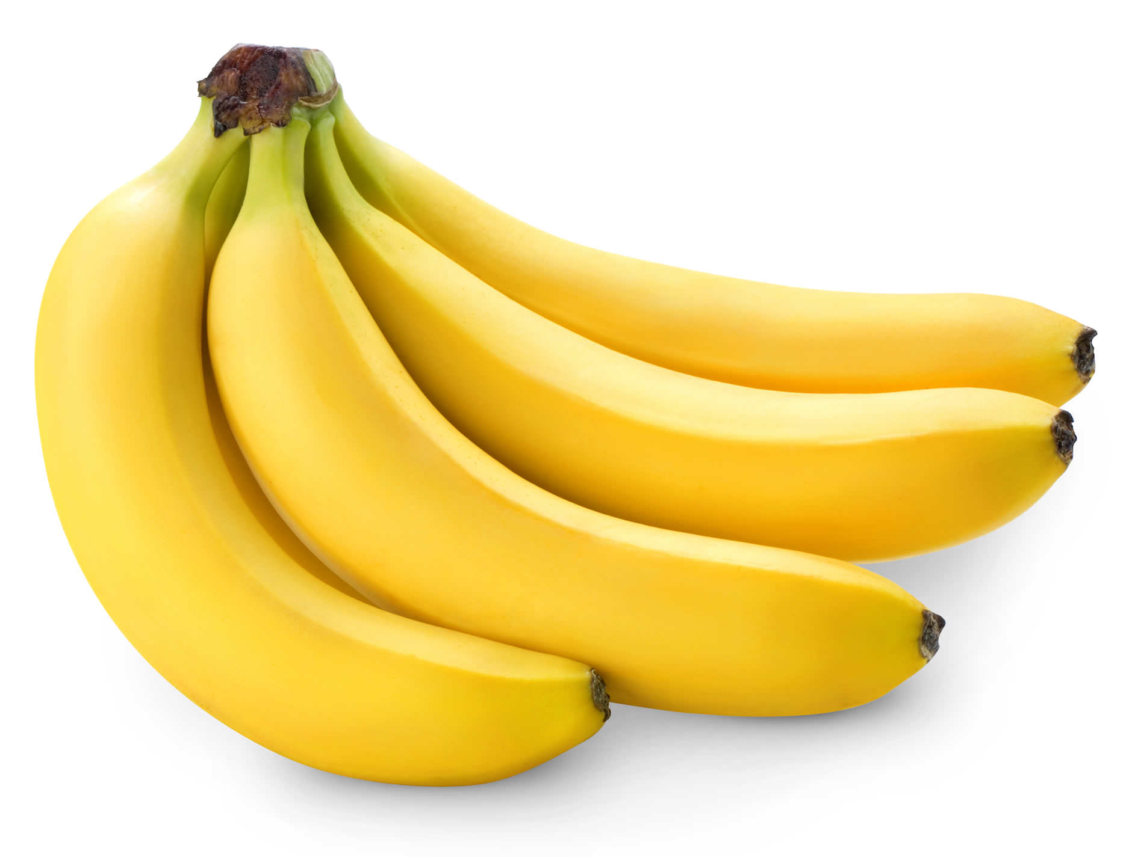
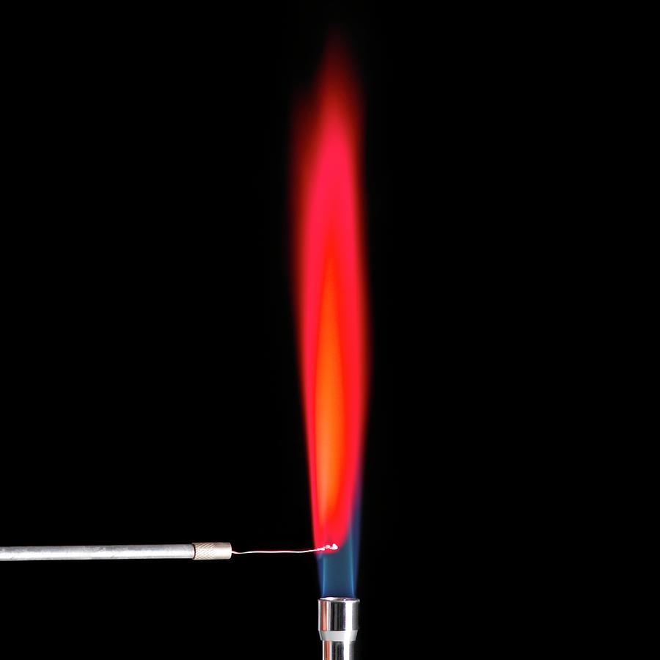
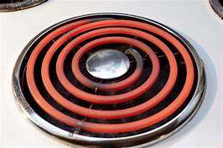
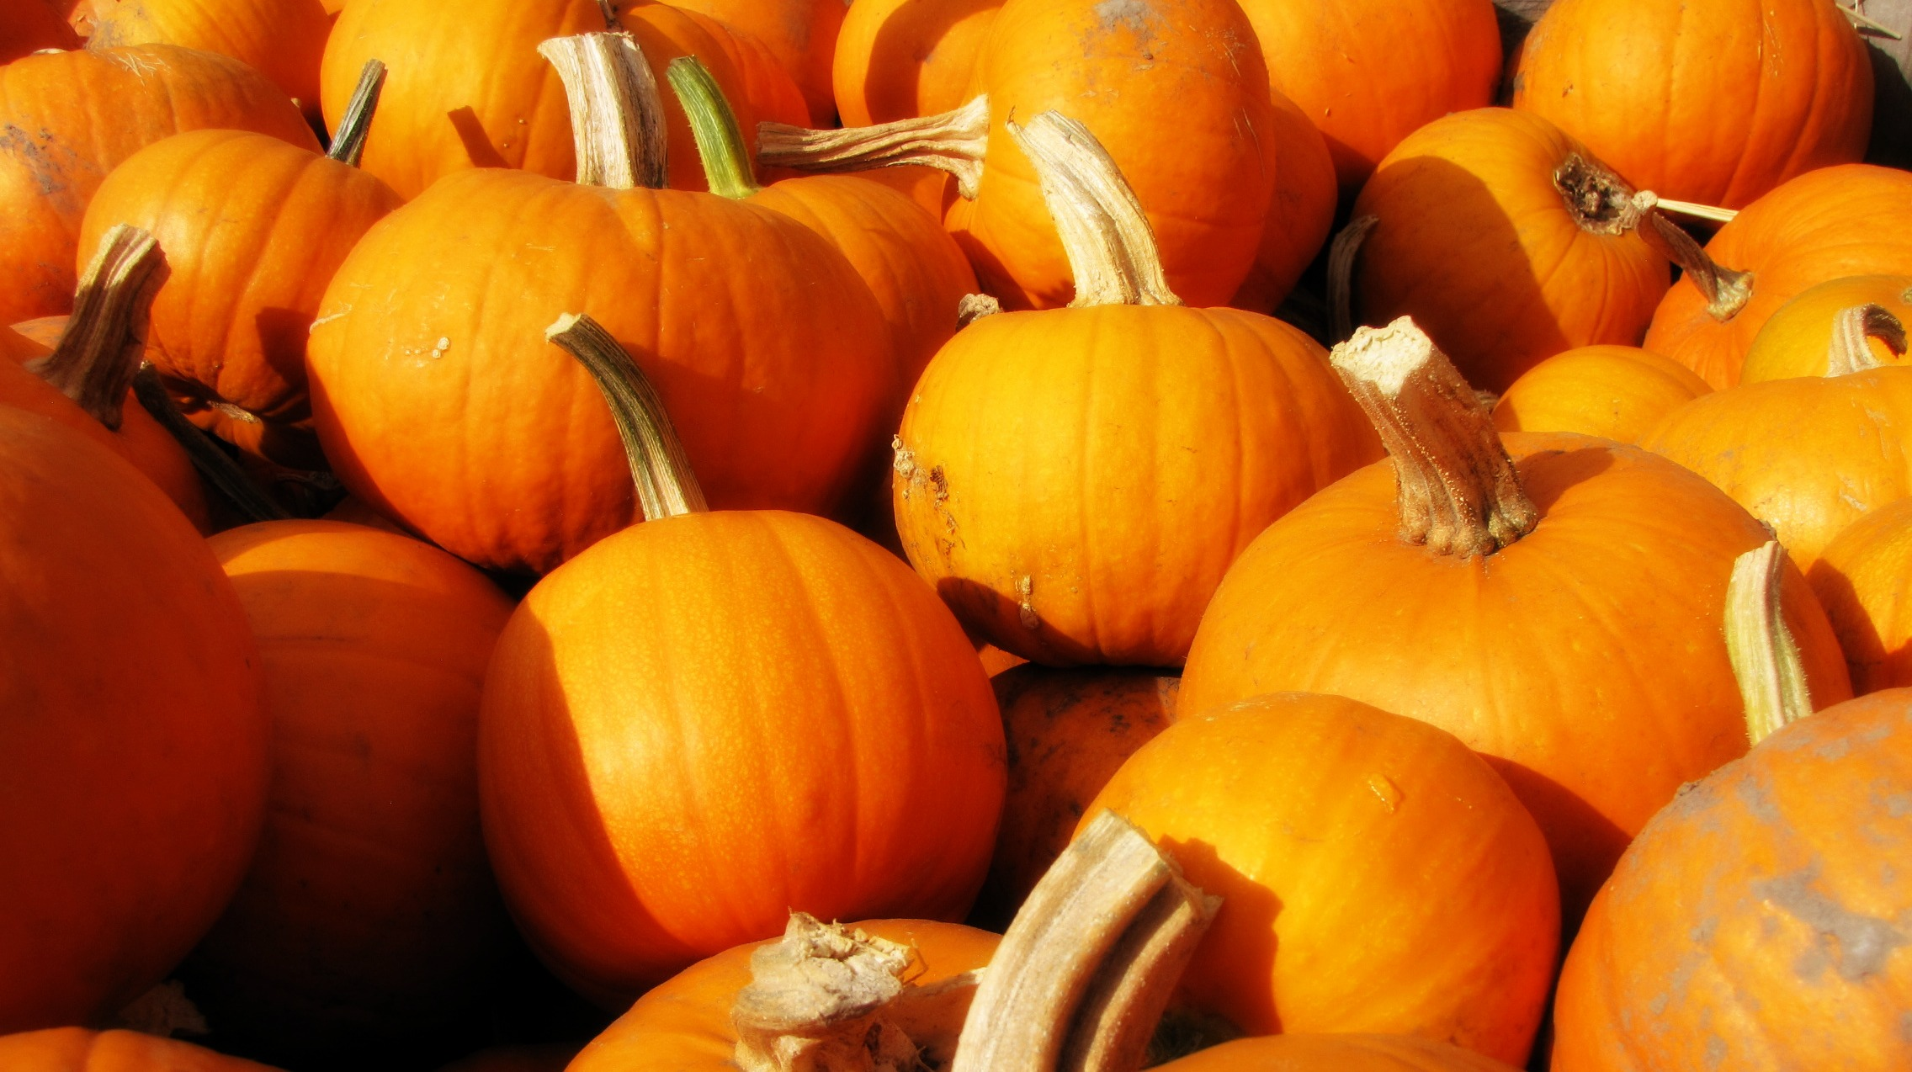
The difference between glowing and reflecting
Glowing
Reflecting

Slide 15
The difference between glowing and reflecting
Glowing
Reflecting
Electron goes to higher orbital, emits a photon as it drops to lower-energy orbital

Slide 16
The difference between glowing and reflecting
Glowing
Reflecting
Electron goes to higher orbital directly by absorbing a photon

Slide 17
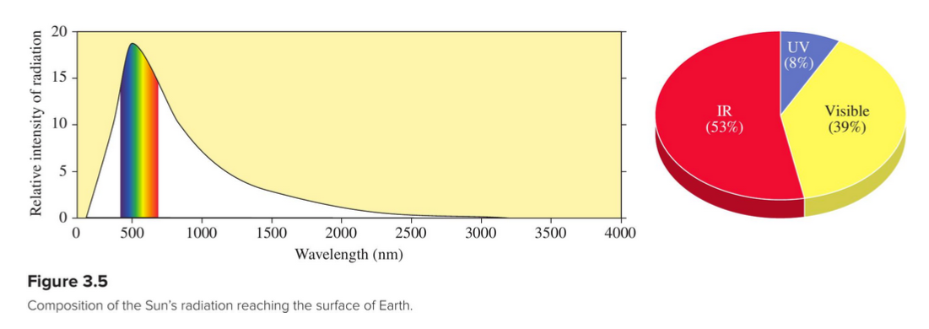
We’ve seen that sunlight has all visible colors (and IR and uv)
Sunlight is almost 40% visible light

Slide 18
For chlorophyll, there’s an energy gap that matches red light
The shapes of molecular orbitals are very different – they’re not s-orbitals, p-orbitals. However, the same ideas apply (HOMO, LUMO, gaps)
LUMO
Red photon
HOMO
Molecular orbital energies of chlorophyll (artist’s conception)
Leaf with green chlorophyll pigment
Chlorophyll molecule
Chlorophyll HOMO

Slide 19
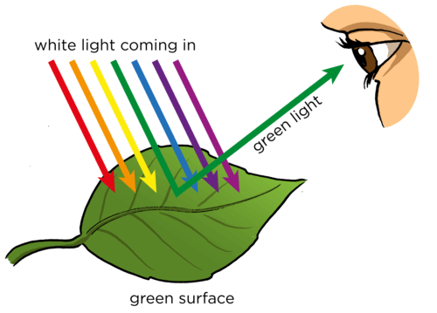
If more green light is bounced off, the leaf looks green!
Here, the orbital gap that that absorbs the most photons corresponds to red light. The orbital gap that absorbs the fewest photons corresponds to green light. So the leaf looks green.
There’s usually a connection between these: they’re complementary colors

Slide 20
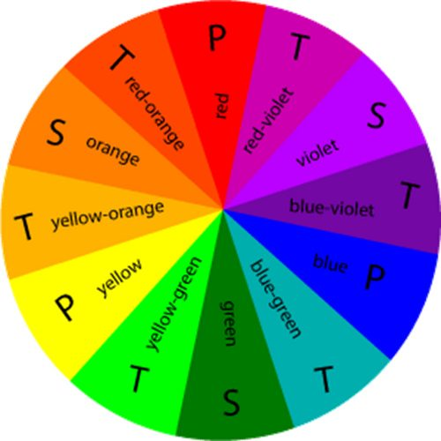
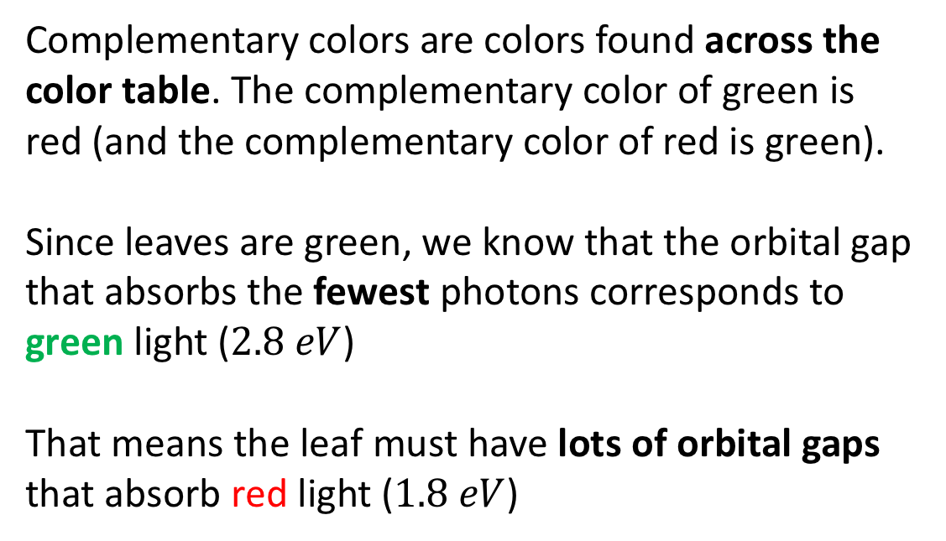
Complementary colors …
1.8 eV
Complementary colors are colors found across the color table. The complementary color of green is red (and the complementary color of red is green).
Since leaves are green, we know that the orbital gap that absorbs the fewest photons corresponds to green light ($2.8 eV$)
That means the leaf must have lots of orbital gaps that absorb red light ($1.8 eV$)
2.1 eV
3.6 eV
3.3 eV
2.4 eV
2.7 eV
3.0 eV

Slide 21
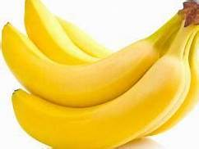
Complementary colors …
Bananas reflect ...
The complementary color is …
1.8 eV
2.1 eV
3.6 eV
3.3 eV
2.4 eV
2.7 eV
3.0 eV

Slide 22
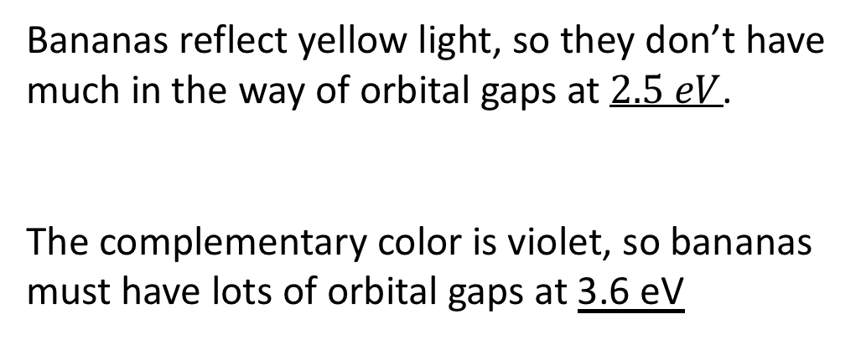
Complementary colors …
Bananas reflect yellow light, so they don’t have much in the way of orbital gaps at $2.5 eV$.
The complementary color is violet, so bananas must have lots of orbital gaps at 3.6 eV
1.8 eV
2.1 eV
3.6 eV
3.3 eV
2.4 eV
2.7 eV
3.0 eV

Slide 23
Complementary colors …
Pumpkins reflect ...
The complementary color is …
1.8 eV
2.1 eV
3.6 eV
3.3 eV
2.4 eV
2.7 eV
3.0 eV

Slide 24
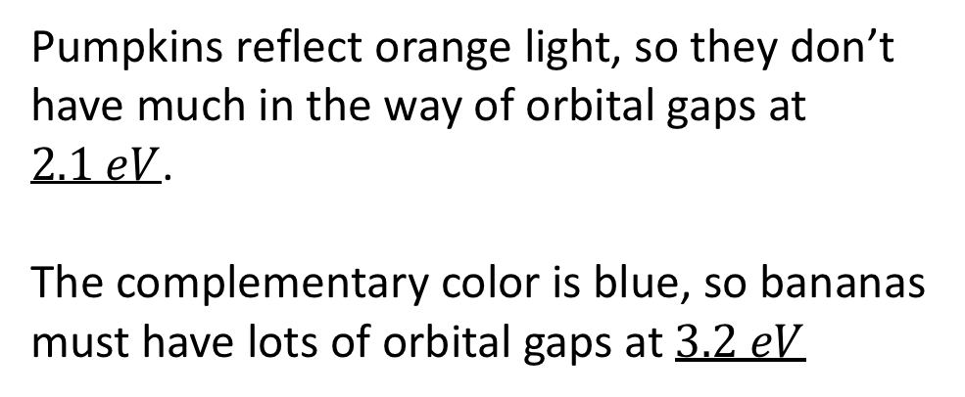
Complementary colors …
Pumpkins reflect orange light, so they don’t have much in the way of orbital gaps at $2.1 eV$.
The complementary color is blue, so bananas must have lots of orbital gaps at $3.2 eV$
1.8 eV
2.1 eV
3.6 eV
3.3 eV
2.4 eV
2.7 eV
3.0 eV

Slide 25
Summary so far …
Orbitals are not just for atoms – there are orbitals for molecules too, but the shapes are not the familiar atomic s-orbital (spherical), p-orbital (double-dumbbell), etc.
There’s a big difference between glowing and reflecting:
Glowing: after exposure to a flame, cosmic ray, or electrical voltage, electrons in a substance are excited to higher-energy orbitals, then fall back down to lower-energy orbitals, emitting photons as they fall.
Reflecting: When you illuminate a substance with full-spectrum light, the color you see is light reflected from the original source (like the sun). This light doesn’t match many orbital gaps in the substance. The complementary color, however, does have lots of matching orbital gaps; this is the color of maximum absorption.
About 40% of sunlight consists of a full spectrum of visible light (all colors); the rest of the photons are in the uv or IR range, which humans can’t see.
Next … how does light move electrons from lower to higher orbitals (or: how does the movement of electrons cause light to be emitted)?

Slide 26


We’ve said the color of a photon is related to its wavelength …
Red light:
Photon energy = $1.8 eV$
$λ_{red}=7000 Å$
But what exactly is that wavelength all about?
Blue light:
Photon energy = $3.6 eV$
$λ_{blue}=4000 Å$

Slide 27
Another way to think about light: as a way to jiggle charged particles
Beam of light
-

Slide 28
Another way to think about light: as a way to jiggle charged particles
-

Slide 29
Another way to think about light: as a way to jiggle charged particles
-

Slide 30
Another way to think about light: as a way to jiggle charged particles
-

Slide 31
Another way to think about light: as a way to jiggle charged particles
-

Slide 32
Another way to think about light: as a way to jiggle charged particles
-

Slide 33
Another way to think about light: as a way to jiggle charged particles
-

Slide 34
Another way to think about light: as a way to jiggle charged particles
-

Slide 35
Another way to think about light: as a way to jiggle charged particles
-

Slide 36
Another way to think about light: as a way to jiggle charged particles
-

Slide 37
Another way to think about light: as a way to jiggle charged particles
-

Slide 38
Another way to think about light: as a way to jiggle charged particles
-

Slide 39
Another way to think about light: as a way to jiggle charged particles
-

Slide 40
Another way to think about light: as a way to jiggle charged particles
-

Slide 41
Another way to think about light: as a way to jiggle charged particles
-

Slide 42
Another way to think about light: as a way to jiggle charged particles
-

Slide 43
Another way to think about light: as a way to jiggle charged particles
-

Slide 44
Another way to think about light: as a way to jiggle charged particles
-

Slide 45
Another way to think about light: as a way to jiggle charged particles
-

Slide 46
Another way to think about light: as a way to jiggle charged particles
-

Slide 47
Another way to think about light: as a way to jiggle charged particles
-

Slide 48
Thinking about light as a wave
-

Slide 49
Thinking about light as a wave
-

Slide 50
Thinking about light as a wave
-

Slide 51
Thinking about light as a wave
-

Slide 52
Thinking about light as a wave
-

Slide 53
Thinking about light as a wave
-

Slide 54
Thinking about light as a wave
-

Slide 55
Thinking about light as a wave
-

Slide 56
Thinking about light as a wave
-

Slide 57
Thinking about light as a wave
-

Slide 58
Thinking about light as a wave
-

Slide 59
Thinking about light as a wave
-

Slide 60
Thinking about light as a wave
-

Slide 61
Thinking about light as a wave
-

Slide 62
Thinking about light as a wave
-

Slide 63
Thinking about light as a wave
-

Slide 64
Thinking about light as a wave
-

Slide 65
Thinking about light as a wave
-

Slide 66
Thinking about light as a wave
-

Slide 67
Thinking about light as a wave
-

Slide 68
Thinking about light as a wave
-

Slide 69


A note about the direction of the jiggling (acceleration)
The direction of acceleration is perpendicular to the path (beam) of the light
Red light:
Photon energy = $1.8 eV$
This
+
Not this
+
Violet light:
Photon energy = $3.6 eV$
https://en.wikipedia.org/wiki/Light#/media/File:Light_dispersion_conceptual_waves.gif

Slide 70
Summary so far …
The effect of light on a substance is to accelerate charged particles (so far we’ve considered only electrons) up and down in a repeating, wavelike fashion.
The acceleration occurs perpendicular to the path of the light
How does this explain how light moves electrons from lower to higher orbitals?

Slide 71
How light moves electrons from lower to higher orbitals
Chlorophyl molecule
Speed of light
-

Slide 72
How light moves electrons from lower to higher orbitals
Chlorophyl molecule
Speed of light
-

Slide 73
How light moves electrons from lower to higher orbitals
Chlorophyl molecule
Speed of light
-

Slide 74
How light moves electrons from lower to higher orbitals
Chlorophyl molecule
Speed of light
-

Slide 75
How light moves electrons from lower to higher orbitals
Chlorophyl molecule
-
Speed of light

Slide 76
How light moves electrons from lower to higher orbitals
Chlorophyl molecule
-
Speed of light

Slide 77
How light moves electrons from lower to higher orbitals
Chlorophyl molecule
-
Speed of light

Slide 78
How light moves electrons from lower to higher orbitals
Chlorophyl molecule
Speed of light
-

Slide 79
How light moves electrons from lower to higher orbitals
Chlorophyl molecule
Like pushing somebody on a swing, the frequency of pushing has to match the natural frequency of the thing being pushed.
In this case, the pushing is being done by the light, and the thing being pushed is an electron.
This matching is called resonance.
Speed of light
-

